Slide 1
File System Overview and File Transfer
Jens Mueller, PhD
HPC Services, Miami University

Slide 2
Directory Structure on Linux system
[muellej@mualhplp01:~] $ ls -ls /
total 420
0 lrwxrwxrwx. 1 root root 7 Aug 20 2018 bin -> usr/bin/
4 dr-xr-xr-x. 5 root root 4096 May 28 10:33 boot/
0 drwxr-xr-x. 20 root root 3480 May 28 10:32 dev/
16 drwxr-xr-x. 165 root root 12288 Jul 21 09:10 etc/
280 drwxr-xr-x. 3552 root root 282624 Jul 21 13:01 home/
0 lrwxrwxrwx. 1 root root 7 Aug 20 2018 lib -> usr/lib/
0 lrwxrwxrwx. 1 root root 9 Aug 20 2018 lib64 -> usr/lib64/
0 drwxr-xr-x. 3 root root 23 Sep 6 2018 media/
0 drwxr-xr-x. 7 root root 79 Jul 20 12:53 mnt/
0 drwxr-xr-x. 10 root root 133 Feb 11 11:03 opt/
0 dr-xr-xr-x. 3946 root root 0 May 28 10:32 proc/
4 dr-xr-x---. 19 root root 4096 Jul 21 16:35 root/
0 drwxr-xr-x. 46 root root 1460 Jul 22 08:37 run/
0 lrwxrwxrwx. 1 root root 8 Aug 20 2018 sbin -> usr/sbin/
4 drwxrwxrwt. 9 root root 4096 Jul 22 13:32 scratch/
8 drwxrwxrwt. 56 root root 8192 Jul 22 13:32 shared/
40 drwxrwsr-x. 425 root software 36864 Jul 22 13:32 software/
0 drwxr-xr-x. 2 root root 6 Apr 11 2018 srv/
0 dr-xr-xr-x. 13 root root 0 May 28 10:32 sys/
60 drwxrwxrwt. 840 root root 40960 Jul 22 13:29 tmp/
0 drwxr-xr-x. 14 root root 165 Nov 29 2018 usr/
4 drwxr-xr-x. 24 root root 4096 Feb 11 10:42 var/

Slide 3
Data Storage
Local drives on the servers:
/tmp or scratch space
operating system files and services
“Networked” drives, managed through separate servers:
User “home” spaces
Application software
Networked scratch space for parallel jobs’ tmp space
“Shared” spaces for research groups
Backup storage: tape (old), disk drives (SSDs modern)
Some HPC centers have a “high speed file system” in addition to the ones above for fast I/O
I/O to the different storage spaces has different latencies!

Slide 4
User Home Spaces
Subfolders/directories can be created in user home folder
Similar appearance as Windows/Mac with Desktop, Trash etc. folders
Permissions so that they can only be accessed by individual user (and sys admins if needed)
At MU are subjected to quota: 500GB base allocation, charges apply for data exceeding that
Are mounted on all compute nodes: are visible from all machines on the cluster

Slide 5
File Transfer
Files can be transferred from and to the cluster
Transfer speed is limited by internet speed from/to cluster and from/to client computer location
Different way exist to transfer files:
Stand-alone tools: filezilla, WinSCP
Integrated remote-desktop tools: MobaXterm, NX Nomachine
Long-term archival possible to Cloud services (Google drive)
Google Drive has free unlimited storage for MU affiliates (limitation is download/upload speeds

Slide 6
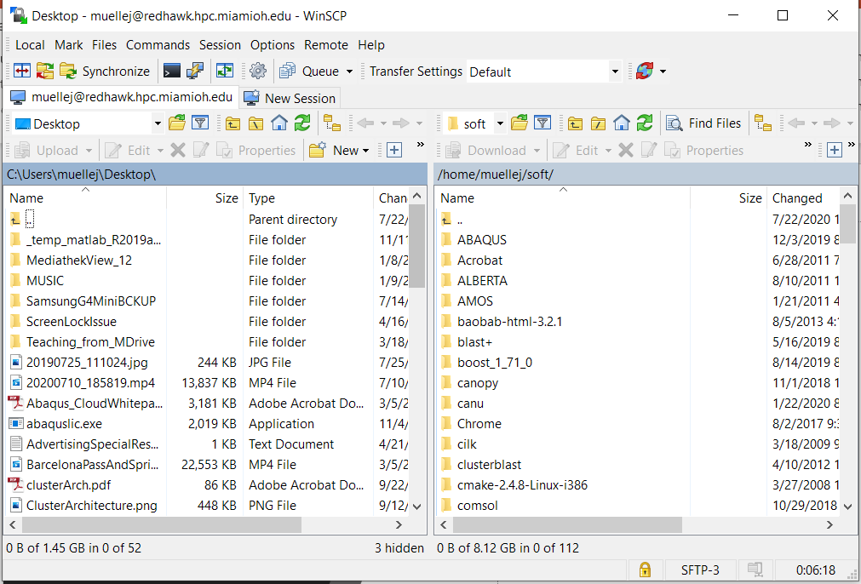
WinSCP

Slide 7
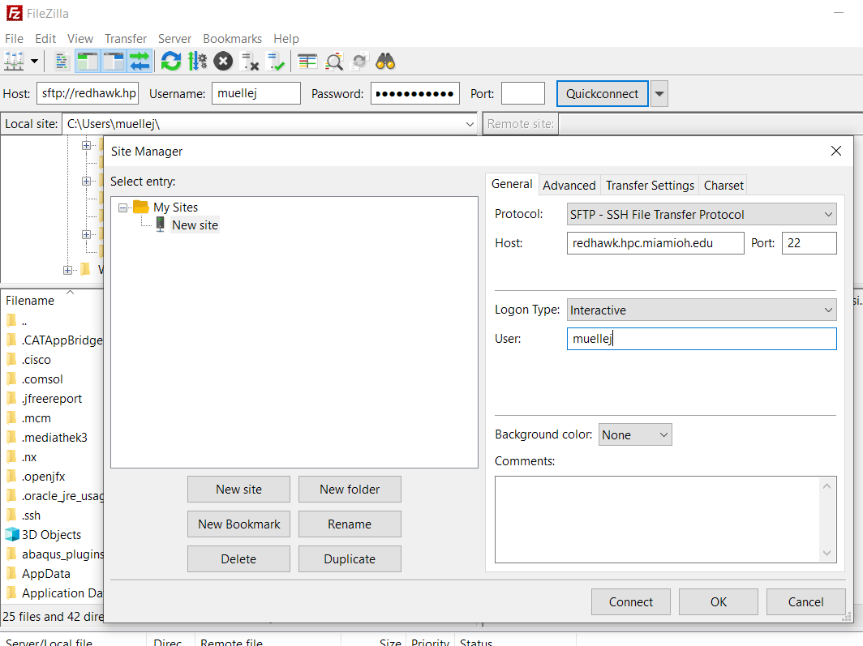
Filezilla

Slide 8
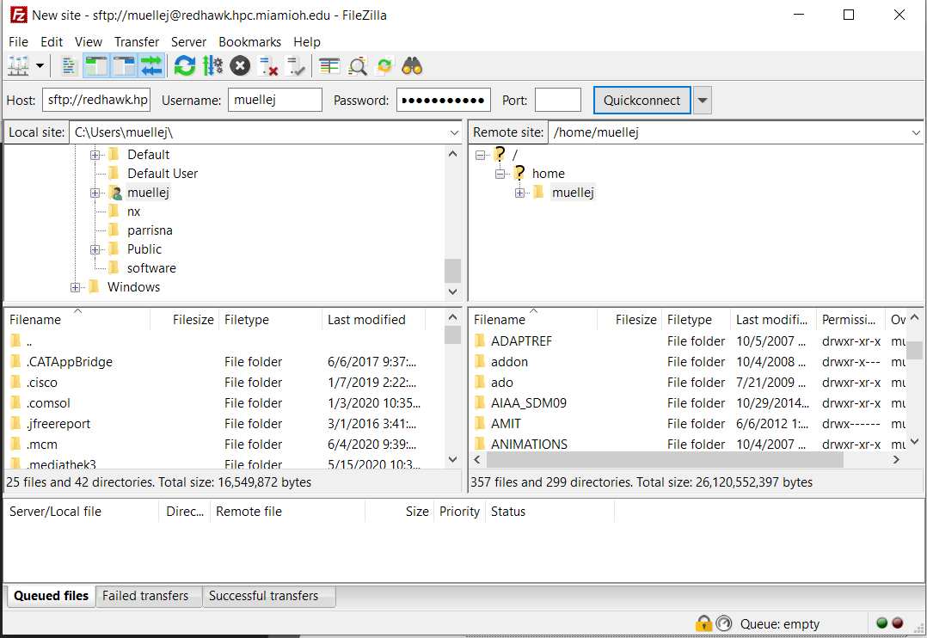
Filezilla

Slide 9
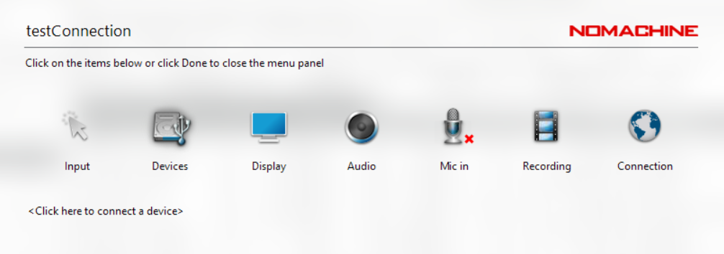
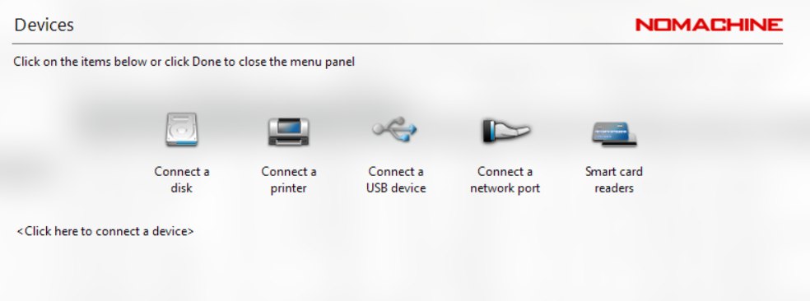
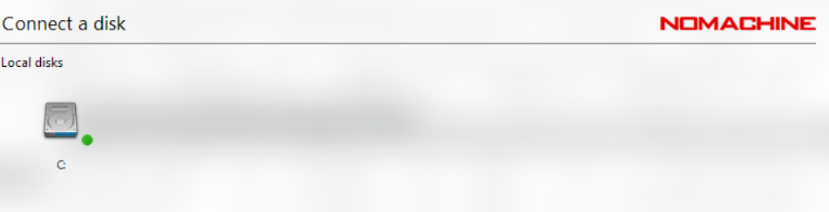
NX Integrated File Transfer

Slide 10
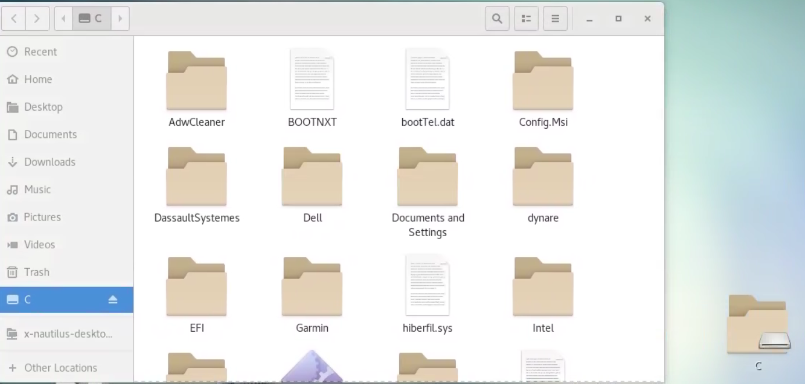
NX Integrated File Transfer

